Slide 1
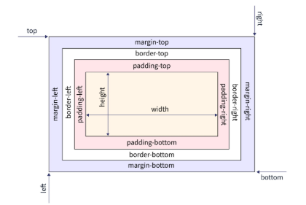
CSS Box Model?
The CSS Box Model describes all the HTML elements of the webpage as rectangular boxes.

Slide 2
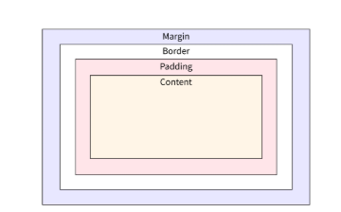
Properties of the CSS Box Model
Content The content area contains the real content of the element,
such as text, an image, or a video player. It is the area where the
content gets displayed on the webpage. Its dimensions can be
modified using properties like width and height.
Padding The padding area is the space around the content area and within the element's border. It creates extra space inside the element's border and uses the same background as the element itself. The dimensions of the padding is determined by the padding-top, padding-right, padding-bottom, padding-left, and shorthand padding properties.
Border The border area is the space around the padding area and within the margin. It includes the element's borders and wraps the content and any padding. Its size and style can be controlled using border and related properties. For example, it can be set to dotted, dashed, solid, double, none, or hidden. It can also have rounded corners using the border-radius property.
Margin The margin area is the transparent space outside the element's border and doesn't have any background color. The margin wraps the content, padding, and border and mostly used to separate the element from other HTML elements on the web page. The size of the margin area is specified using the margin-top, margin-right, margin-bottom, margin-left, and shorthand margin properties.

